Slide 1
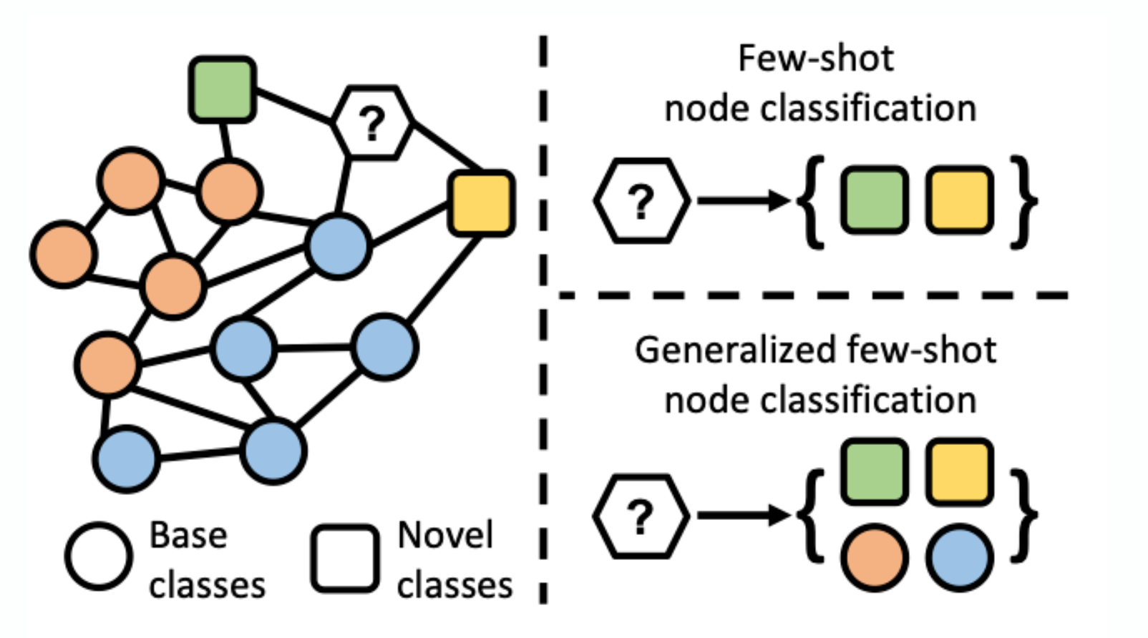
Virtual Node Tuning for Few-shot Node Classification
Jay Patel, Shrey Patel, Ankush Singh

Slide 2

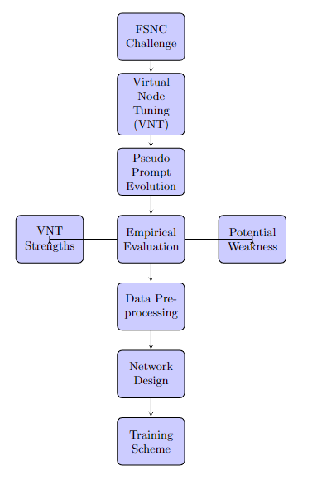
Abstract
Overcoming the difficulty of classifying few-shot nodes (FSNC) using sparse labeled data.
Virtual Node Tuning (VNT): An innovative method for embedding virtual nodes that makes use of a pre trained graph transformer.
Introducing meta-learning-enhanced graph-based pseudo hints to adjust embeddings for FSNC in sparse-label situations. Empirical findings demonstrate the advantage of VNT on four benchmark datasets.
Efficiency with sparse labels and low computational overhead are two of VNT's strong points. The effectiveness of VNT depends on the virtual prompt design and the underlying pretrained transformer. Unsupervised tasks like node recovery and masked link prediction are part of the preprocessing step.
A GPPE module and virtual nodes to the core transformer are added to the network.
Using cross-entropy loss, the training approach incorporates task-specific post-initial learning fine-tuning.

Slide 3
Problem Addressed from the research paper
From The paper, the problem of few-shot node classification (FSNC) on symbolic graphs—where training is limited to a small number of labeled nodes per class—is discussed. In order to tackle this problem, a pre trained graph transformer is employed as the encoder in the Virtual Node Tuning (VNT) framework, which injects virtual nodes as soft prompts in the embedding space. These virtual nodes can be modulated node embeddings for each unique FSNC job by optimizing them with few-shot labels in new classes. Furthermore, a module for Graph-based Pseudo Prompt Evolution (GPPE) is developed to facilitate effective information transfer in situations when labels are scarce.

Slide 4

Problem to be Considered
A real-world problem of Financial Fraud Detection as an application of the virtual Node tuning for few-shot node classification. The below are the highlights for the problem:
Background
Challenge
Solution
Advantages of VNT for Financial Fraud Detection

Slide 5
Financial Fraud Detection
Background: Detecting financial fraud is a major concern for banks and other financial organizations around the globe. To safeguard consumers and uphold the integrity of the financial system, it is essential to promptly and effectively detect fraudulent conduct given the rising volume of intricate financial transactions that take place every day. But since financial fraud is much less common than regular transactions, one of the biggest obstacles to financial fraud detection is the lack of labeled data. Challenge: In order for rules-based systems or machine learning models used in traditional fraud detection techniques to function correctly, a significant number of labeled instances must be provided. The performance of these models is greatly reduced by the class imbalance issue caused by the rarity of fraud incidents.

Slide 6
Financial Fraud Detection
Solution: Virtual Node Tuning (VNT): To overcome these difficulties, the VNT technique inserts virtual nodes into the embedding space using a pre trained graph transformer. These virtual nodes serve as "soft prompts," and their node embeddings may be tailored for the particular purpose of fraud detection using the few-shot tagged cases that are included in the dataset.
Benefits of VNT in the Identification of Financial Fraud:
Efficiency with Sparse Labels: VNT can efficiently classify transactions with little to no labeled data, avoiding the problem of class imbalance by taking use of the intrinsic structure of transaction networks.
Decreased Computational Requirements: VNT does not necessitate retraining the entire model for fresh fraud cases, in contrast to conventional approaches. Rather, it uses a less computationally intensive method called virtual node tuning to adjust the pretrained model.

Slide 7
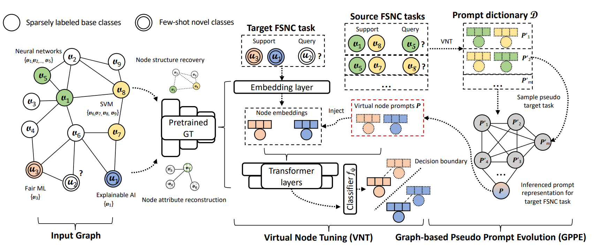
Virtual Node Tuning: Algorithm Overview

Slide 8
Formulation for Problem: Virtual Node Tuning for Few-shot Node Classification
Let's define a graph G=(V,E,X), where V represents the set of vertices, E represents the set of edges, and X denotes the node features.
The conventional FSNC tasks are denoted as 𝑁N-way 𝐾K-shot 𝑅R-query node classification tasks, where:
N is the number of classes,
K is the number of labeled nodes per class (support set),
R is the number of unlabeled nodes per class (query set).
In traditional FSNC, there exists a disjoint set of base classes Cbase​ and novel classes Cnovel​, where Cbase​∩Cnovel​=∅.

Slide 9
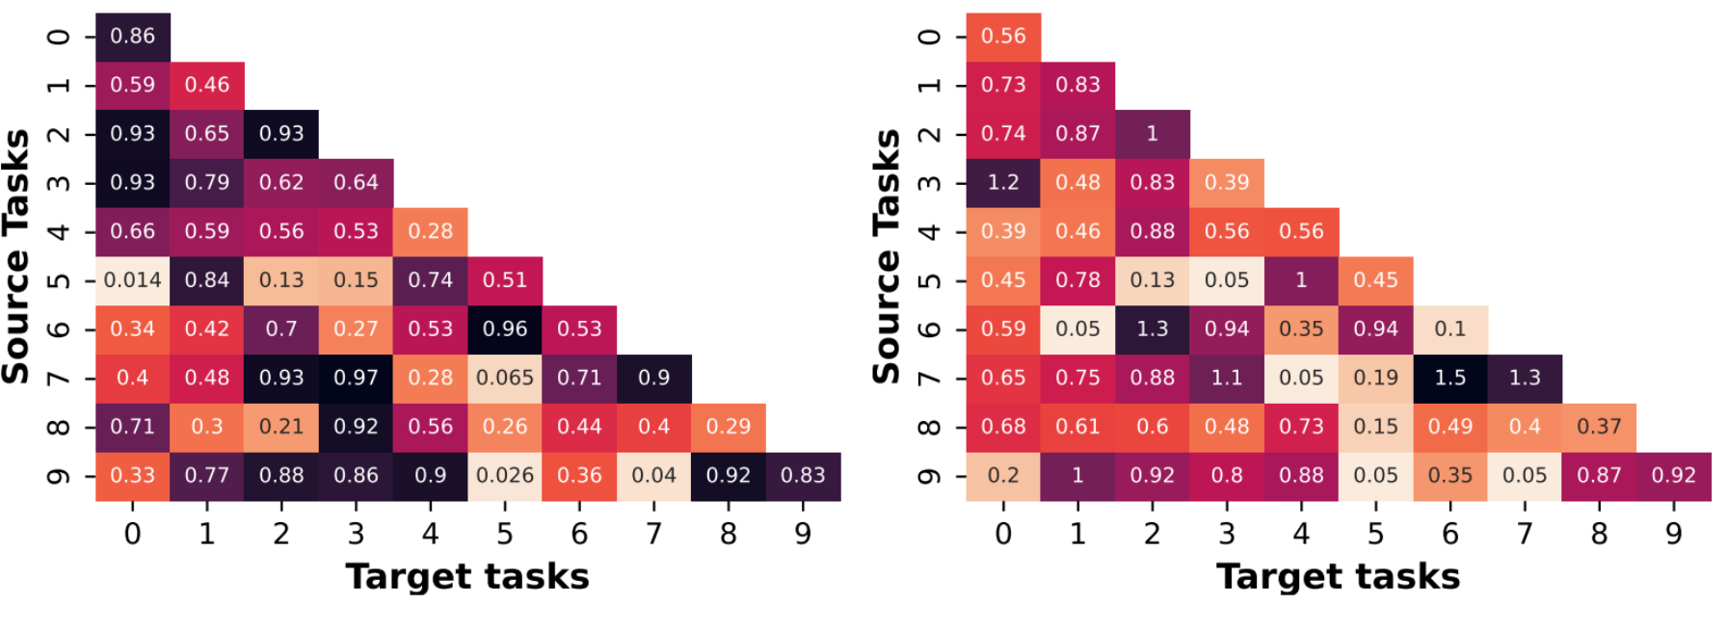
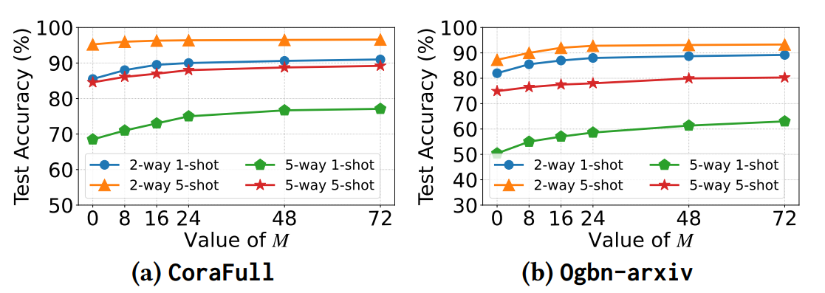
Post-Training Model Evaluation Metrics
Prompt Initialization Strategy and Ensemble
Scale of Graph Transformer (GT)
Evaluation Metrics

Slide 10
Definition 3. General Few-shot Node Classification:
For a graph 𝐺=(𝐴,𝑋)G=(A,X) with node features 𝑋X and adjacency matrix 𝐴A, and a disjoint node label space 𝐶={𝐶𝑏𝑎𝑠𝑒,𝐶𝑛𝑜𝑣𝑒𝑙}C={Cbase​,Cnovel​}, the generalized FSNC problem is to train on 𝑀M tasks from 𝐶𝑏𝑎𝑠𝑒Cbase​ and classify nodes in tasks sampled from 𝐶𝑛𝑜𝑣𝑒𝑙Cnovel​ with few-shot labels.
Mathematically, the objective is to optimize the model on the support set S from Cbase​ for each N-way K-shot task and predict the labels for the query set Q from Cnovel​:
where 𝐿 is the loss function (e.g., cross-entropy), fψ​ is the classifier, XS​ and AS​ are the features and adjacency matrix for the support set S, YS​ are the labels for S, and XQ​ and AQ​ are the features and adjacency matrix for the query set Q.

Slide 11
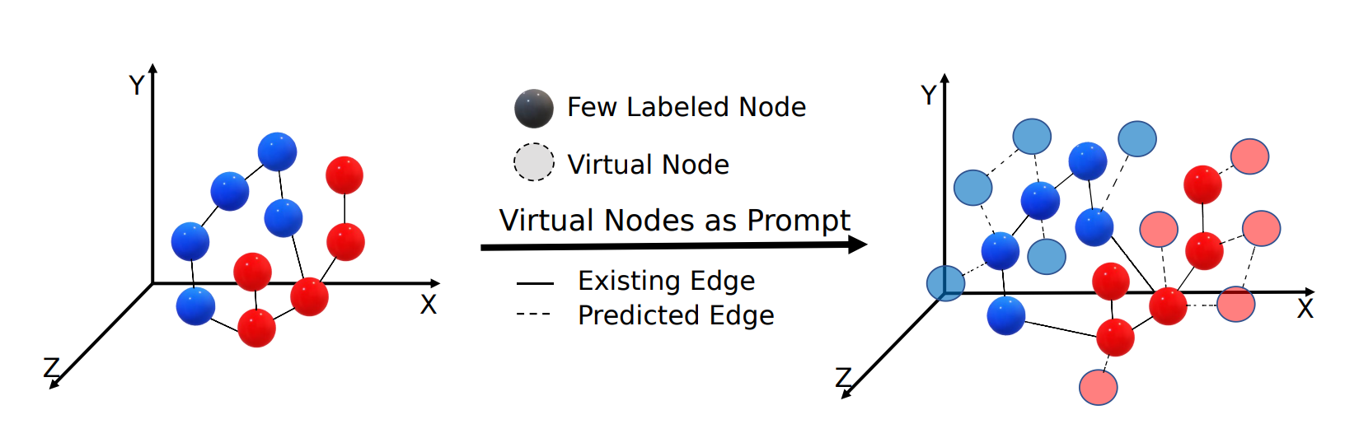
Training Scheme and Optimization in Virtual Node Tuning for Few-Shot Node Classification
Pretraining the Graph Transformer (GT):
Prompt Initialization and Tuning
Loss Functions and Training Sequence
Graph-based Pseudo Prompt Evolution (GPPE)

Slide 12


Dataset Overview:
This project utilizes the "Bitcoin Alpha trust weighted signed network" dataset, which represents a trust network of users from the Bitcoin Alpha platform, a digital currency exchange. Each entry in the dataset captures the trustworthiness ratings between users, providing a basis for few-shot node classification aimed at fraud detection

Slide 13
Data Description:
Source: The dataset is sourced from Bitcoin Alpha, a cryptocurrency trading platform where users can rate each other on a scale, typically signifying trustworthiness.
Features:
User IDs: Unique identifiers for users involved in the trust relationship.
Ratings: Numerical values assigned by one user to another, indicating the level of trust.
Timestamps: The time at which the rating was given, allowing temporal analysis of trust evolution.

Slide 14
Dataset statistics:
Nodes | 3,783
Edges | 24,186
Range of edge weight | -10 to +10
Percentage of positive edges | 93%

Slide 15
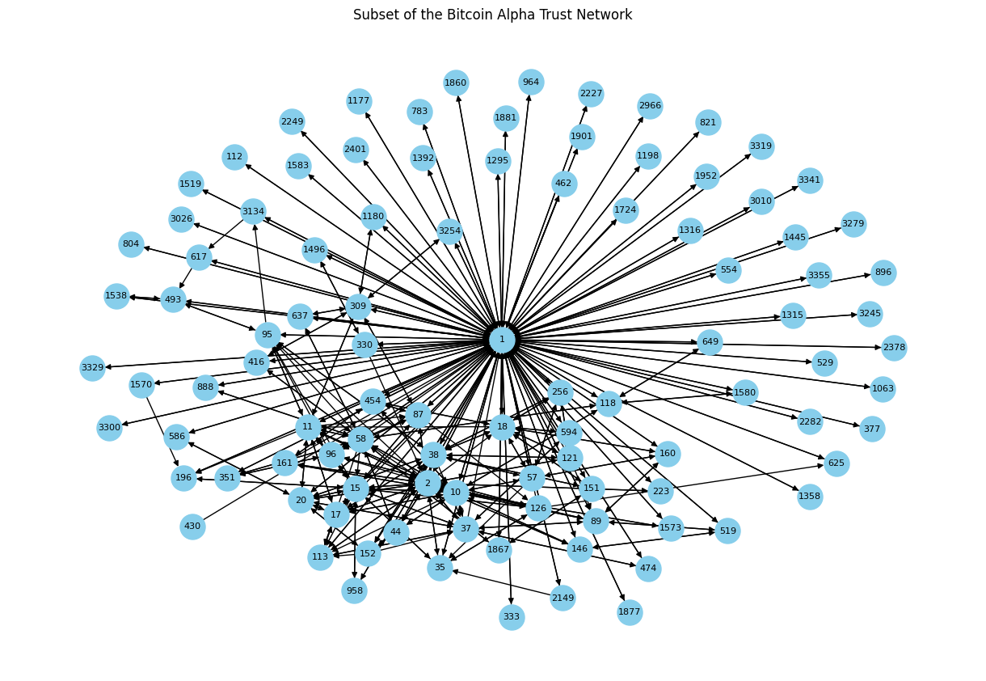

Slide 16
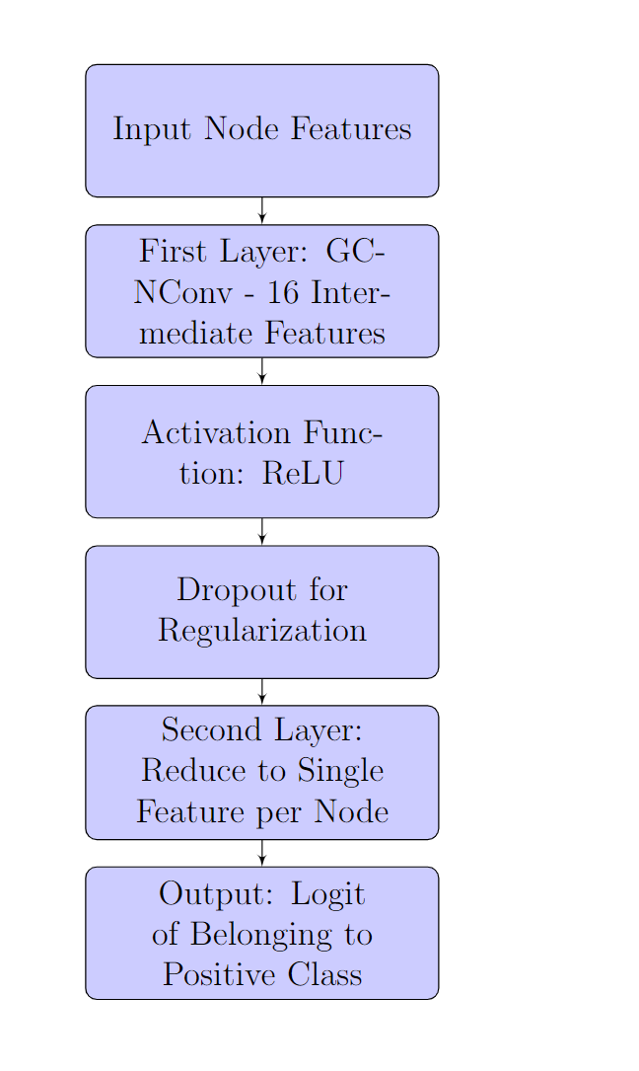
Network Design/Model:
Graph Convolutional Network (GCN): A two-layer GCN model was implemented for the task, which includes the following layers:
First Layer: This is a GCNConv layer that transforms the original node features into 16 intermediate features. The ReLU activation function is applied to introduce non-linearity, followed by dropout for regularization.
Second Layer: This layer reduces the 16-dimensional feature space to a single feature per node, which represents the logit of belonging to the positive class .

Slide 17

Code Snippet
class GCN(torch.nn.Module):
def __init__(self, num_features, num_classes):
super(GCN, self).__init__()
self.conv1 = GCNConv(num_features, 16)
self.conv2 = GCNConv(16, num_classes)
def forward(self, data):
x, edge_index = data.x, data.edge_index
x = self.conv1(x, edge_index)
x = F.relu(x)
x = F.dropout(x, training=self.training)
x = self.conv2(x, edge_index)
return x
This snippet defines a simple two-layer GCN architecture that is used for the node classification task .

Slide 18
Training Strategy
The dataset was normalized to ensure continuous indexing of node identifiers. The edges were prepared into an edge_index tensor, and simple node features were assigned for each node. Binary labels were determined based on the rating being positive or negative .
An 80/20 split was made between training and validation sets. The binary cross-entropy with logits loss function was used, which is suitable for binary classification tasks where model outputs are logits. Adam optimizer with a learning rate of 0.01 was employed to minimize the loss function .

Slide 19
Code snippet
# Load and prepare data
df = pd.read_csv('/content/soc-sign-bitcoinalpha.csv', header=None, ...)
# Normalize node indices, prepare edge_index, define node features and binary labels
data = Data(x=node_features, edge_index=edge_index, y=labels)
This code loads the dataset and prepares it by normalizing node indices and creating the edge_index tensor needed for the GCN. It also sets up node features and labels for training .

Slide 20
Performance Analysis
The initial loss was relatively high but consistently decreased over the training epochs, indicating effective learning and generalization. The model did not show significant overfitting, as evidenced by the close convergence of training and validation loss .

Slide 21

Code Snippet
model = GCN(1, 1)
optimizer = torch.optim.Adam(model.parameters(), lr=0.01)
criterion = torch.nn.BCEWithLogitsLoss()
for epoch in range(100):
model.train()
optimizer.zero_grad()
out = model(data)
loss = criterion(out.squeeze(), data.y.float())
loss.backward()
optimizer.step()
The training loop is where the model is trained for 100 epochs using the Adam optimizer and binary cross-entropy with logits loss function. This snippet is critical as it embodies the learning process .

Slide 22
Meta-Learning Application (MAML)
The training loop included a Model-Agnostic Meta-Learning (MAML) setup, which prepares the graph neural network for quick adaptation to new tasks with minimal data. A function for the MAML update was implemented that makes a copy of the model and performs a gradient update to simulate adaptation to new tasks .

Slide 23
Network Properties Analysis:
In-degree and out-degree calculations, along with network density metrics, were conducted to understand the structure of the graph and its sparsity. NetworkX library was utilized for this purpose .
Visualization of a subgraph and computation of additional node features like average rating given, average rating received, degree centrality, and clustering coefficient were performed to inform feature engineering .

Slide 24
Code Snippet
G = nx.Graph()
# Add edges and nodes to the graph
nx.set_node_attributes(G, node_attributes)
This snippet demonstrates how the network properties are analyzed using the NetworkX library. The attributes set on nodes may be used as features in the GCN model .

Slide 25
Evaluation
Confusion Matrix:
The confusion matrix is a crucial tool in our model evaluation, offering insights into not only the number of correct and incorrect predictions but also the types of errors made by the model. Our confusion matrix reveals the following:
True Positives (TP): The instances where the model correctly predicted the positive class.
True Negatives (TN): The instances where the model correctly predicted the negative class.
False Positives (FP): The instances where the model incorrectly predicted the negative class as positive.
False Negatives (FN): The instances where the model incorrectly predicted the positive class as negative.
Through this matrix, we can calculate other performance metrics like accuracy, precision, recall, and F1 score, which provide a holistic view of the model's performance. The visualization of the confusion matrix in our study has been generated using matplotlib, reflecting the model's classification results in a visually intuitive manner.

Slide 26

Code snippet
# Confusion Matrix code snippet
cm = confusion_matrix(val_labels, val_predictions)
fig, ax = plt.subplots()
cax = ax.matshow(cm, cmap=plt.cm.Blues)
fig.colorbar(cax)
ax.set_xlabel('Predicted')
ax.set_ylabel('Actual')
ax.set_xticklabels(['', 'Negative', 'Positive'])
ax.set_yticklabels(['', 'Negative', 'Positive'])
plt.title('Confusion Matrix')
plt.show()

Slide 27
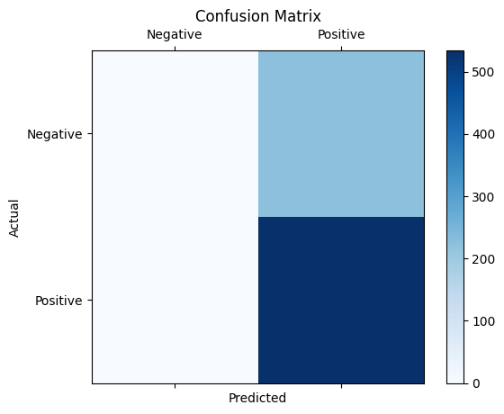

Slide 28
References
Tan, Zhen, et al. “Virtual Node Tuning for Few-Shot Node Classification.” arXiv.Org, 9 June 2023, arxiv.org/abs/2306.06063.
University, Zhen Tan Arizona State, et al. “Virtual Node Tuning for Few-Shot Node Classification: Proceedings of the 29th ACM SIGKDD Conference on Knowledge Discovery and Data Mining.” ACM Conferences, 1 Aug. 2023, dl.acm.org/doi/abs/10.1145/3580305.3599541.
“KDD 2023 - Virtual Node Tuning for Few-Shot Node Classification.” YouTube, YouTube, 12 July 2023, www.youtube.com/watch?v=vcaoAVBVPBQ.
“Deep Learning Monitor.” Virtual Node Tuning for Few-Shot Node Classification - Paper Detail, deeplearn.org/arxiv/386472/virtual-node-tuning-for-few-shot-node-classification. Accessed 25 Apr. 2024.

